Slide 1
Software Engineering Lab
Building .NET Applications on the Oracle Database with Microsoft Visual Studio
Lab 2 – ODP.Net
DML statements in connected layer

Slide 2
Agenda
Retrieving Actor Information for selected ID using Bind Variables
DML Operations using Bind Variables
Inserting New Actor Information
Updating Actor Information for selected ID
Deleting Actor Information for selected ID

Slide 3
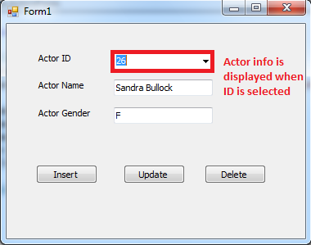
1. Retrieving Actor Info for the selected ID

Slide 4
Retrieving Actor Info for the selected ID
ComboBox SelectedIndexChanged Event:
Occurs when the SelectedIndex property of the comboBox has changed. (When the user selects value from the list)

Slide 5
Parameterized Query
In order to pass values from the c# application to the SQL statement, we should use:
Bind Variables in the SQL Statement of the OracleCommand
Put the value in a parameter and add it to the OracleCommand

Slide 6
Parameterized Query: 1- Bind Variables
Bind variables allow you to create parameterized queries where user input is used to build the SQL statement.
Bind variables can be used with SELECT, INSERT, UPDATE , and DELETE statements

Slide 7
Parameterized Query: 1- Bind Variables (cont.)
Bind variables are placeholders in a SQL statement that begin with a single colon (":")
OracleCommand c = new OracleCommand();
c.Connection = conn;
c.CommandText = "select actorname,gender from Actors where ActorID=:id";
c.CommandType = CommandType.Text;
Notes:
//bind variable names can be numbers or characters
cmd.CommandText = "select * from Actors where ActorID=:id";
cmd.CommandText = "select * from Actors where ActorID=:1";

Slide 8
Parameterized Query: 2- Oracle Parameters
In order to use bind variables from your ODP.NET programs, use the OracleParameter objects associated with the OracleCommand.
c.Parameters.Add("id", cmb_ID.SelectedItem.ToString());
Notes:
Use the Add Method in the Parameters Property of the command object to create new parameter:
Add(string, object)
This method adds an OracleParameter object to the collection using the supplied name and object value.
Bind variable : named “Bind” cause it is linked to another object ( which is the parameter)

Slide 9
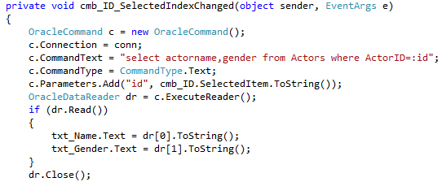
Retrieving Actor Info for the selected ID
Notes:
OracleCommand c = new OracleCommand();
c.Connection = conn;
c.CommandText = "select actorname,gender from Actors where ActorID=:id";
c.CommandType = CommandType.Text;
c.Parameters.Add("id", cmb_ID.SelectedItem.ToString());
OracleDataReader dr = c.ExecuteReader();
if (dr.Read())
{
txt_Name.Text = dr[0].ToString();
txt_Gender.Text = dr[1].ToString();
}
dr.Close();

Slide 10
2- Adding New Actor (Insert Statement)

Slide 11
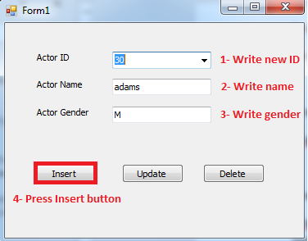
Adding New Actor (Insert)
Before inserting new ID, make sure that it doesn’t exist in the combobox
Notes:
Actor info provided in the Values clause (Insert into Actors values (….)) are collected from the form. Therefore, there should be a way to pass values from controls on the form to the SQL Insert Statement (By using bind variables)
Before inserting new ID, make sure that it doesn’t exist in the combobox

Slide 12
Parameterized Query: 1- Bind Variables
Bind variables are placeholders in a SQL statement that begin with a single colon (":")
OracleCommand cmd = new OracleCommand();
cmd.Connection = conn;
cmd.CommandText = "insert into Actors values (:id,:name,:gender)";
Notes:
//bind variable names can be numbers or characters
cmd.CommandText = "insert into Actors values (:id,:name,:gender)";
cmd.CommandText = "insert into Actors values (:1,:2,:3)";

Slide 13
Parameterized Query: 2- Oracle Parameters
In order to use bind variables from your ODP.NET programs, use the OracleParameter objects associated with the OracleCommand.
cmd.Parameters.Add("id", cmb_ID.Text);
cmd.Parameters.Add("name", txt_Name.Text);
cmd.Parameters.Add("gender", txt_Gender.Text);
you must add the parameters in the same order as they appear in the SQL statement.
Notes:
Use the Add Method in the Parameters Property of the command object to create new parameter:
Add(string, object)
This method adds an OracleParameter object to the collection using the supplied name and object value.
Bind variable : named “Bind” cause it is linked to another object ( which is the parameter)

Slide 14
ExecuteNonQuery()
This method executes a SQL statement and returns the number of rows affected.
Used with Insert, Update, Delete
int r = cmd.ExecuteNonQuery();
It returns -1 if no rows are affected

Slide 15
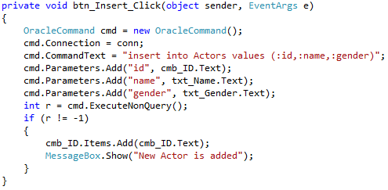
Adding New Actor (Insert)
After the new actor has been inserted successfully, add its ID to the combobox
Notes:
OracleCommand cmd = new OracleCommand();
cmd.Connection = conn;
cmd.CommandText = "insert into Actors values (:id,:name,:gender)";
cmd.Parameters.Add("id", cmb_ID.Text);
cmd.Parameters.Add("name", txt_Name.Text);
cmd.Parameters.Add("gender", txt_Gender.Text);
int r = cmd.ExecuteNonQuery();
if (r != -1)
{
cmb_ID.Items.Add(cmb_ID.Text);
MessageBox.Show("New Actor is added");
}

Slide 16
3- Updating Actor Information for a selected ActorID (Update Statement)

Slide 17
Updating Actor Information for a selected ActorID
Remember Update syntax:
UPDATE table
SET column = value [, column = value, ...]
[WHERE condition];

Slide 18
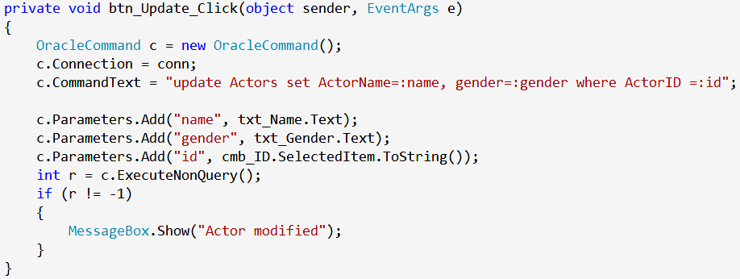
Updating Actor Information
Notes:
OracleCommand c = new OracleCommand();
c.Connection = conn;
c.CommandText = "update Actors set ActorName=:name, gender=:gender where ActorID =:id";
c.Parameters.Add("name", txt_Name.Text);
c.Parameters.Add("gender", txt_Gender.Text);
c.Parameters.Add("id", SelectedItem.ToString());
int r = c.ExecuteNonQuery();
if (r != -1)
{
MessageBox.Show("Actor modified");
}

Slide 19
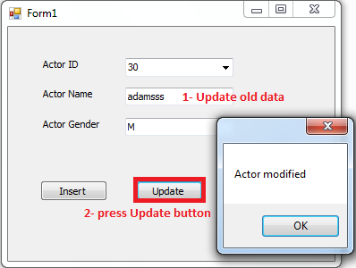
Updating Actor Information

Slide 20
4- Deleting Actor Information for a selected ActorID (Delete Statements)

Slide 21
Deleting Actor Information for a selected ActorID
Remember Delete syntax:
DELETE [FROM] table
[WHERE condition];

Slide 22
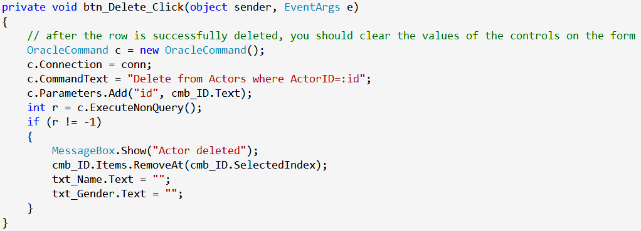
Deleting Actor Information
Notes:
// after the row is successfully deleted, you should clear the values of the controls on the form
OracleCommand c = new OracleCommand();
c.Connection = conn;
c.CommandText = "Delete from Actors where ActorID=:id";
c.Parameters.Add("id", cmb_ID.Text);
int r = c.ExecuteNonQuery();
if (r != -1)
{
MessageBox.Show("Actor deleted");
cmb_ID.Items.RemoveAt(cmb_ID.SelectedIndex);
txt_Name.Text = "";
txt_Gender.Text = "";
}

Slide 23
Thank You

